Slide 1
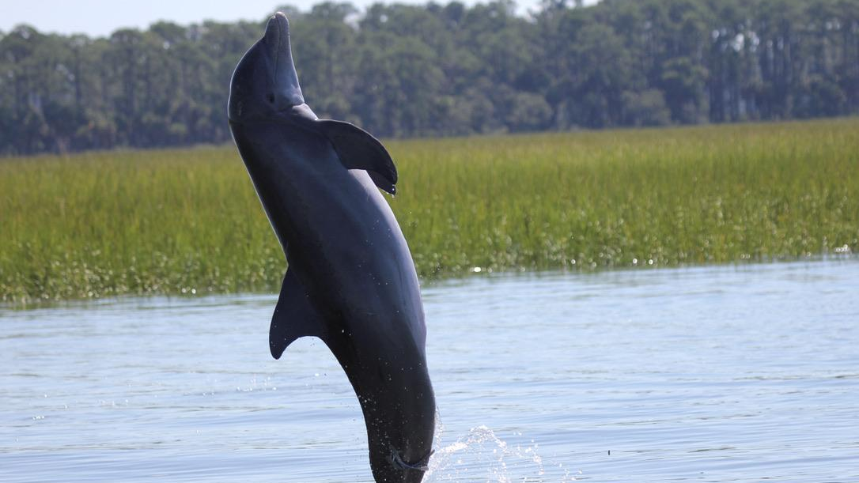


Assessing the relationship between bottlenose dolphin vocalization and abundance patterns in Charleston Harbor, SC
Caroline Tribble | CofC
Dr. Eric Montie | USCB
NMFS Permit #24033
Photographer: C. Tribble

Slide 2
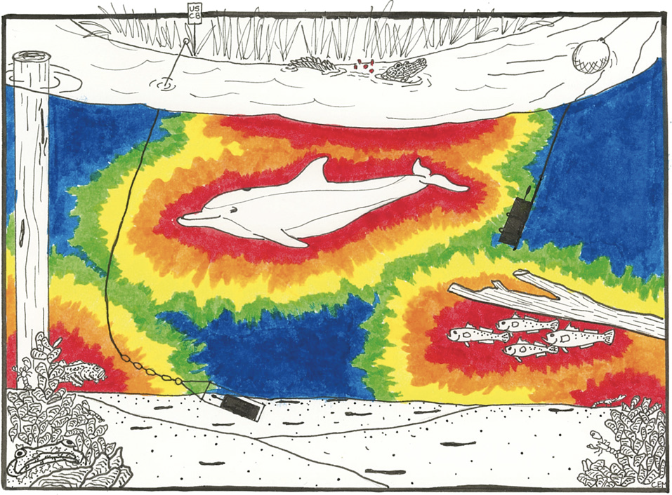
Passive Acoustic Monitoring
Non-invasive approach
Soundscape ecology
Species presence and distribution
Spawning–related choruses
Habitat quality
Behavioral ecology of apex predators
Hydrophone
Instrument frame
Passive Acoustic Recorder
Adapted from Mueller et al. 2020
Notes:
For those of you who have
Understand spatial and temporal rhythms of biological sound in estuarine systems
Illustrated by Claire Mueller displaying how long-term estuarine soundscape monitoring can help us understand acoustic behavior at varying biological, spatial, and temporal scales.
Long-term PAM and photo-ID surveying in the May River found
acoustic and visual detections were both greatest at the mouth of the river. In addition, sightings
peaked in the late summer while vocalizations, predominantly echolocation, peaked in the winter
(Marian, 2020).
This may be associated with seasonal decreases in prey abundance that may
require dolphins to echolocate more to find prey. In a highly developed estuarine ecosystem like
the Charleston Harbor, long-term PAM and visual surveying coupled with assessment of
environmental factors and anthropogenic noise presence may provide a greater understanding of
how vessel noise influences bottlenose dolphin behavior

Slide 3
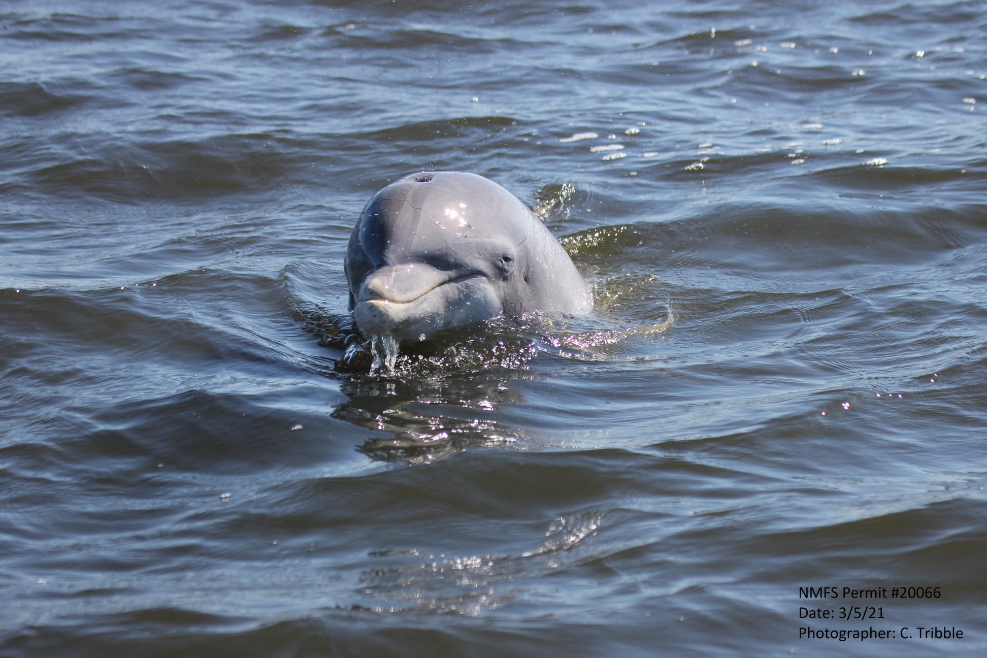
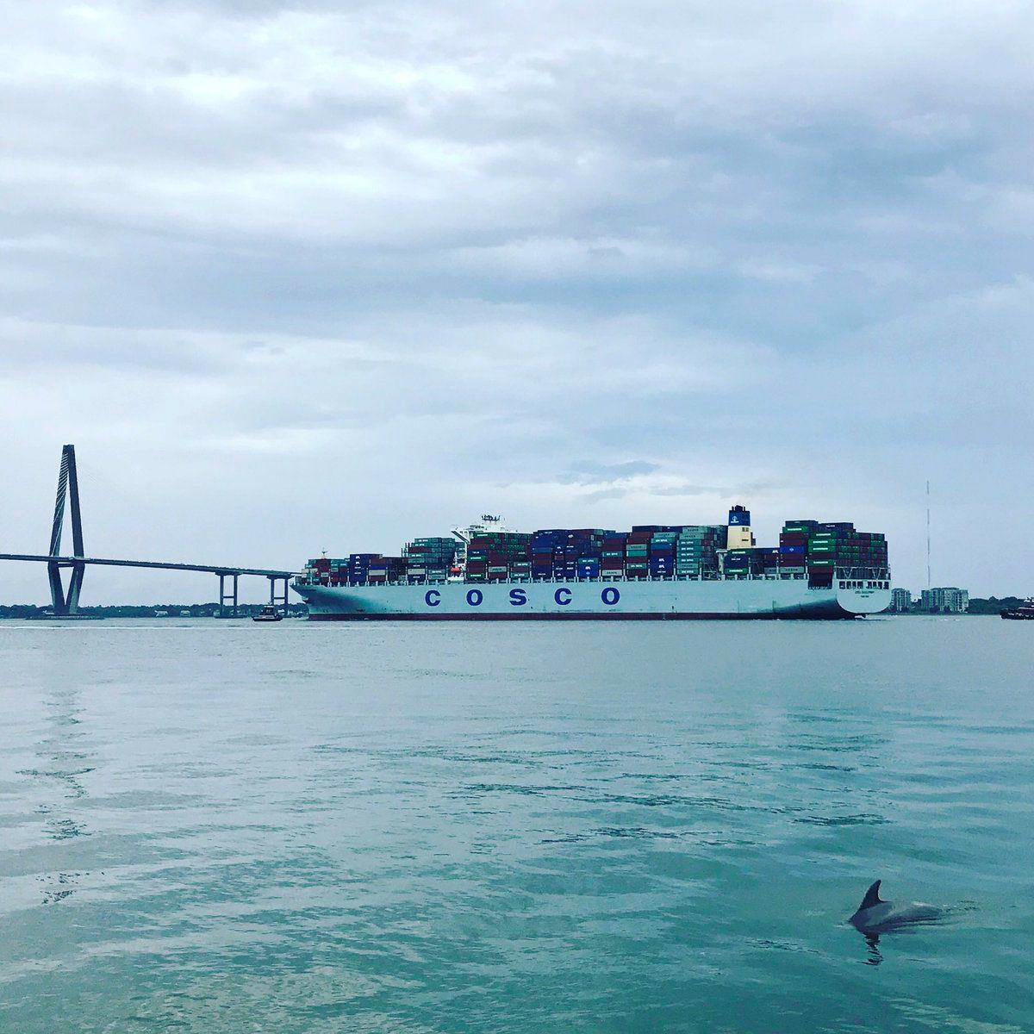
Significance of study
Keystone species
Underwater noise pollution
Dredging impacts
Can passive acoustics serve as a predictor of abundance?
Can these data be used to tease out detection range?
How complex is this relationship?
Notes:
Atlantic common bottlenose dolphins are widely distributed off the South Carolina coast and are representative keystone species within our harbor. They rely on a range of vocalizations to communicate, forage, and navigate in their environment. Charleston Harbor is the fourth largest shipping port on the east coast and the harbor deepening project will make Charleston the deepest on the east coast, further increasing ship traffic. With great ship traffic there is greater noise pollution and potential for masking of signals or hearing loss in dolphins. My thesis project focuses on characterizing dolphin vocalization patterns over space and time in the harbor to better understand the influence of environmental, abundance, and anthropogenic factors on these patterns.
For the purposes of this project, I want to focus on understanding the relationship between acoustic and visual detections of dolphins, and whether these different methods of surveying marine mammal populations are comparable in regard to abundance. So if we observe a large number of dolphins while surveying a site, is it likely we will also see large numbers in vocalizations within the same time period on our acoustic recorders.
One constraint with PAM is that vocalization detections provide a general count of acoustic activity but differentiating individual cetaceans and extrapolating to abundance estimates have proven challenging (Marques et al., 2010; Mellinger et al., 2007; Simard et al., 2015).
This alone has many important implications -
For bottlenose dolphins, can vocalization density (total number of vocalizations) a good predictor of sighting density (total number of dolphins identified) using passive acoustics, lessening the need for visual boat-based abundance surveys – papers
Can we these data to help us better understand the detection range of vocalizations of our recorders – common issue in passive acoustics, Simard paper.
Is this relationship more complex than simply greater vocalizations means more dolphins present – factors to include, papers to support

Slide 4
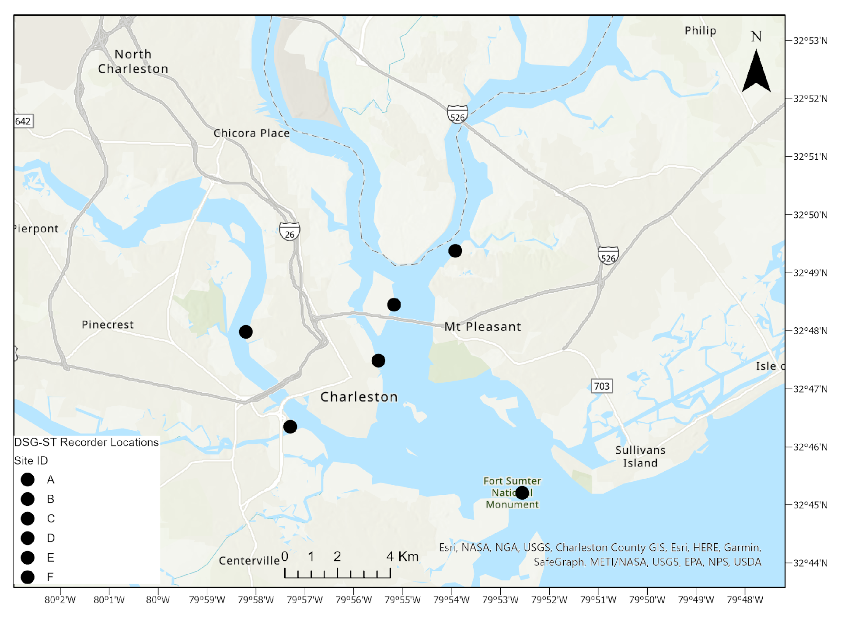
Methodology – Acoustic Surveying
Charleston Harbor
32˚40’N, 79˚55’W
DSG-ST passive acoustic recorders
2 mins every 20 mins
Sampling rate of 96 kHz
Water temperature and water level loggers
Dec 2017 to May 2019
Wando River
Cooper River
A
B
F
Ashley River
C
E
Wando River
Drum Island
SC Aquarium
Ft Sumter
Mouth of Ashley
Citadel
D
Notes:
Placement of recording stations within Charleston Harbor was determined based on core use areas of the Charleston Estuarine System Stock determined by spatial analyses on historical photo-ID surveys and due to their locations within the harbor with stations A, B, C, and D all within the shipping channel while stations E and F are not and are more representative of recreational boat traffic. These recorders are deployed for 3 months at a time then retrieved and acoustic files are manually analyzed to identify fish and dolphin vocalizations

Slide 5
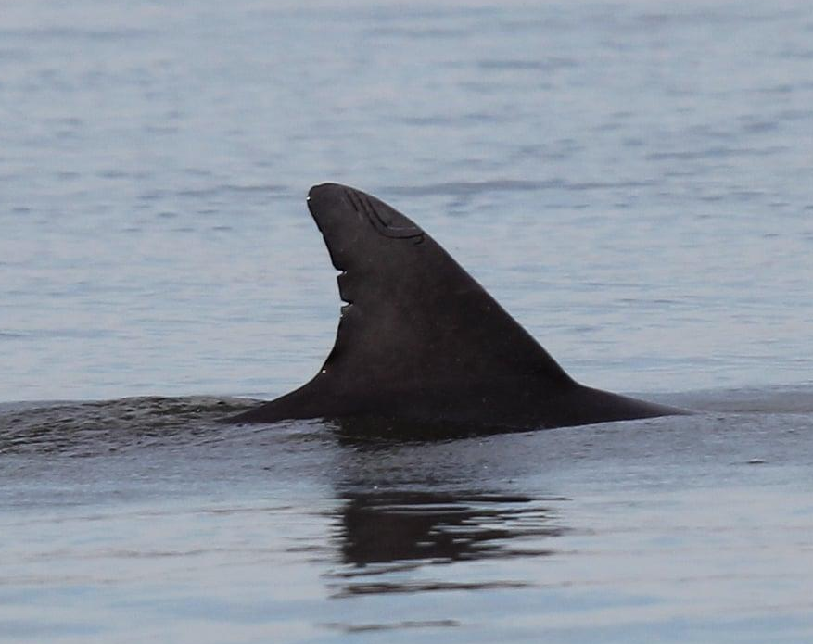
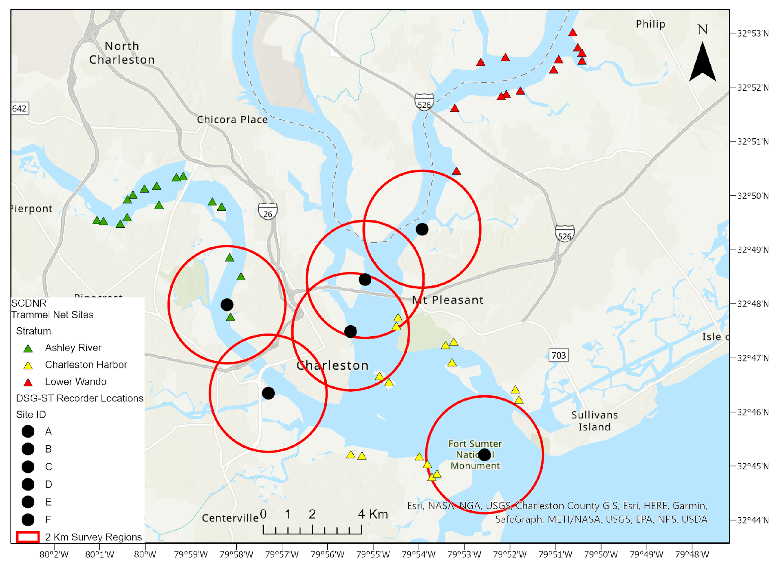
Methodology – Visual Surveying
Bimonthly
Boat-based photo-ID surveys
50 min transects at each site
Dec 2017 to May 2019
Not incorporating photo-ID catalog for this study
A
B
F
C
E
Wando
Drum Island
Aquarium
Mouth
Ashley Lower
Ashley Upper
D
NMFS Permit #24033
Photographer: C. Tribble
Notes:
Conducting these bimonthly surveys in addition to acoustic monitoring we can understand how abundance patterns over space and time may relate to vocalizations
Small vessel-based photo-ID surveys in Charleston Harbor began in June 2017 and were conducted bimonthly within a designated 2 km radius around each recording station. Once dolphin(s) were observed, sighting data collected included GPS location, start and end times of sighting, group size estimates for dolphins, calves, and neonates (i.e., minimum, maximum, and best estimate), weather conditions, water depth (m), and water quality measurements using a YSI Handheld Multiparameter Instrument. Water quality measures included water temperature, salinity, dissolved oxygen, and turbidity. These vessel-based surveys were conducted under General Authorization for Scientific Research Letter of Confirmation No. 18859 issued by NMFS to Dr. Patricia Fair. Best estimates of group size across sightings for total dolphins and total calves will be assessed temporally (i.e. by season, year, and entire study). Photographs were taken of the dorsal fin of each group member to later use photo-ID methods (Speakman et al., 2010; Balmer et al., 2012; Balmer et al., 2018) to identify individual dolphins.

Slide 6



Sampling Design
Acoustic data
Sighting data
Additional factors
Total echolocation bouts
Total whistles
Total burst pulses
Total vocalizations
Noise presence
Fish calling scores:
(0 – no calls, 1 – one, 2 – multiple, 3 – chorusing)
GPS coordinates of sightings
Start/end time
Total dolphins present
Total calves present
Distance from the recorder (m)
Site
season
y ~ x
total dolphins ~ total vocals + site + season + distance + total calves + fish calling
Neg. Binomial GLM, Mixed Effect, Spatial GLM
Notes:
From the sighting data, start and end times of sightings were matched to times of acoustic surveying (every 20 mins)
Sighting sp. data includes - gps lat and long of boat when the dolphins were sighted, date, site, start and end times, total number of dolphins present, total number of calves present, and distance in meters of the sighting in relation to the site’s recorder, season
Acoustic sp. data includes - # echolocation bouts, # whistles, # burst pulses, total # vocals, anthro noise presence (0 or 1), fish (all species) calling score (0,1,2,3)
Potential issue in data with my question: All data described here is coming from sightings of dolphins and does not include instances where they did not see any dolphins in a given site on any given day, though this did sometimes occur. Therefore, I have no zeros in my ‘total number of dolphins present’ and I am working on adding in these data and matching to acoustics on the hour for when they didn’t see a dolphin the entire time surveying a particular site.
Initially thought a mixed effects model would be best to understand possible random effects of site since we do see spatial variation in both vocalizations and sightings. However my data is highly zero-inflated so I am trying negative binomial glm and mixed effects models.
function:
y ~ x
total dolphins ~ total vocalizations + site (factor) + season (factor) + distance from recorder + total calves + fish calling (ordered factor)

Slide 7
Expected Results
Vocalization counts in fall and winter will significantly influence abundance counts
In summer when fish are chorusing, this association will fall apart
Dolphins will vocalize more when calves are present
Notes:
seasonal effect in vocals
dist - detection range
total calves present - more vocal with calves, whistles , paper here
fish calling - passive listening hypothesis

Slide 8
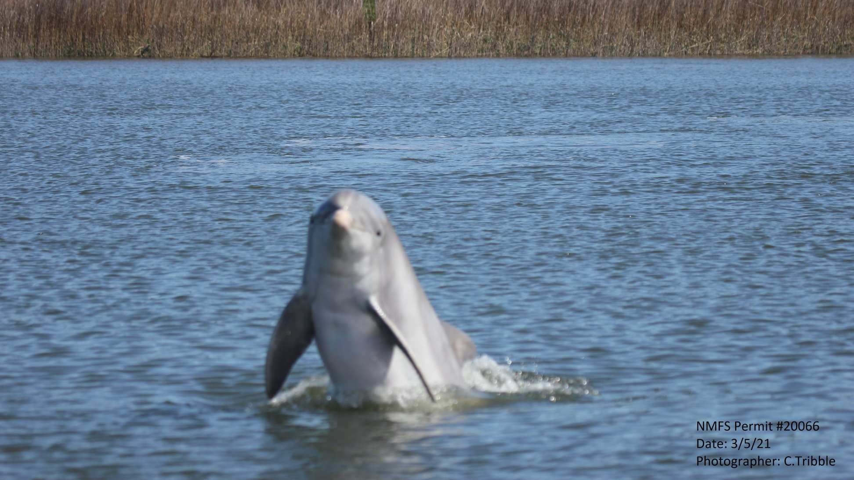
Questions?

